Slide 1
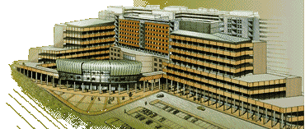
Univeristà “Magna Graecia” di Catanzaro
A.O.U. “Mater Domini”
Cattedra ed U.O. di Cardiologia
Direttore Prof. C. Indolfi
Anticoagulant treatment of deep vein thrombosis
Dr. Vittorio Emanuele
Dirigente Medico, U.O. Cardiologia.
Regional Excellence Center for Interventional Treatment of Cardiovascular Diseases

Slide 2
Background

Slide 3
VTE (DVT and PE)
DVT and PE occurs for the first time in about 1 in 1000 persons each year, and the incidence rises with age to at least 5 in 1000 persons in those over the age of 80 years.
50% of VTE patients have no identifiable risk factors and are identified as having unprovoked VTE.
Recurrent DVT increases the risk of postthrombotic syndrome, a chronic disorder that occurs in 20% to 50% of DVTpatients and is characterized by leg swelling and discomfort; venous ulcers can develop in severe cases.

Slide 4
Patho-Physiology

Slide 5
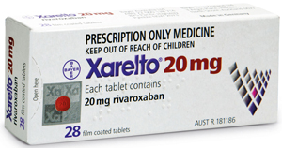

Slide 6
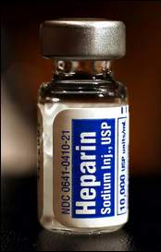
Past
Usual Treatment occurs in 2 overlapping steps. It starts with LMWH, which is overlapped with a vitamin K antagonist. The parenteral anticoagulant is given for at least 5 days and is stopped when the anticoagulant response with warfarin is therapeutic, (INR between 2 and 3). Warfarin is then continued as long-term therapy for a minimum of 3months

Slide 7
Future: NOACs
Four NOACs have been evaluated for VTE treatment: dabigatran (an oral thrombin inhibitor) and rivaroxaban, apixaban, and edoxaban (USA), which are oral factor Xa inhibitors
Rivaroxaban is currently licensed for initial, long-term, and extended VTE treatment, whereas dabigatran is approved (USA) for the latter 2 indications.

Slide 8
Trials Design

Slide 9
Notes:
(PROBE) design (EINSTEIN Trial) = prospective, randomized, open-label, blinded end point evaluation

Slide 10
Trials Results

Slide 11
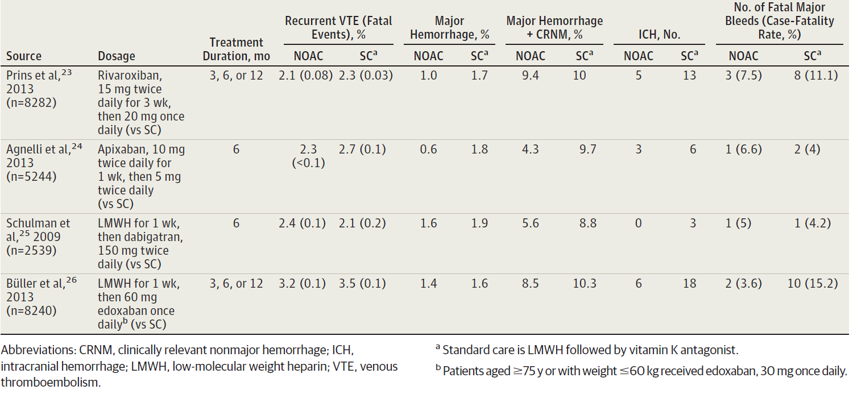
Results of Phase 3 Trials With New Oral Anticoagulants (NOACs)—Acute VTE
Notes:
EINSTEIN (prins) AMPLIFY (Agnelli)

Slide 12
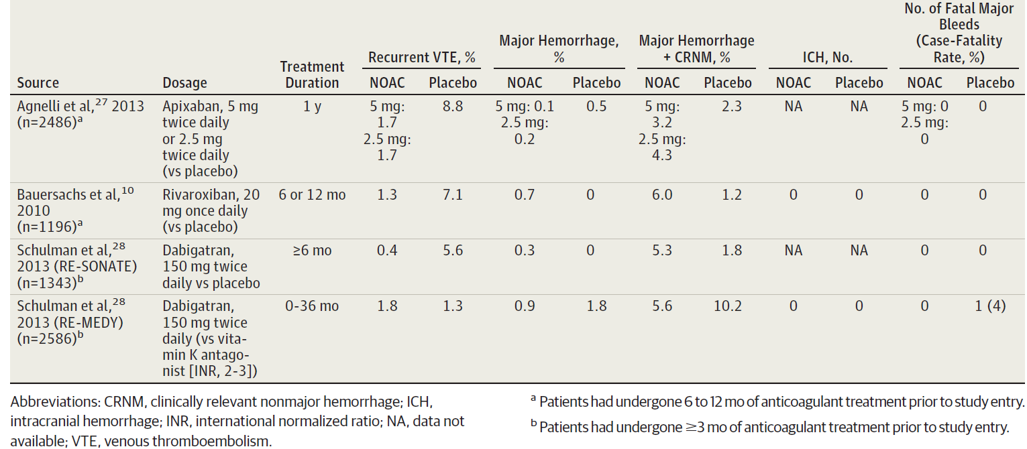
Results of Phase 3 Trials With New Oral Anticoagulants (NOACs)—Extended VTE

Slide 13
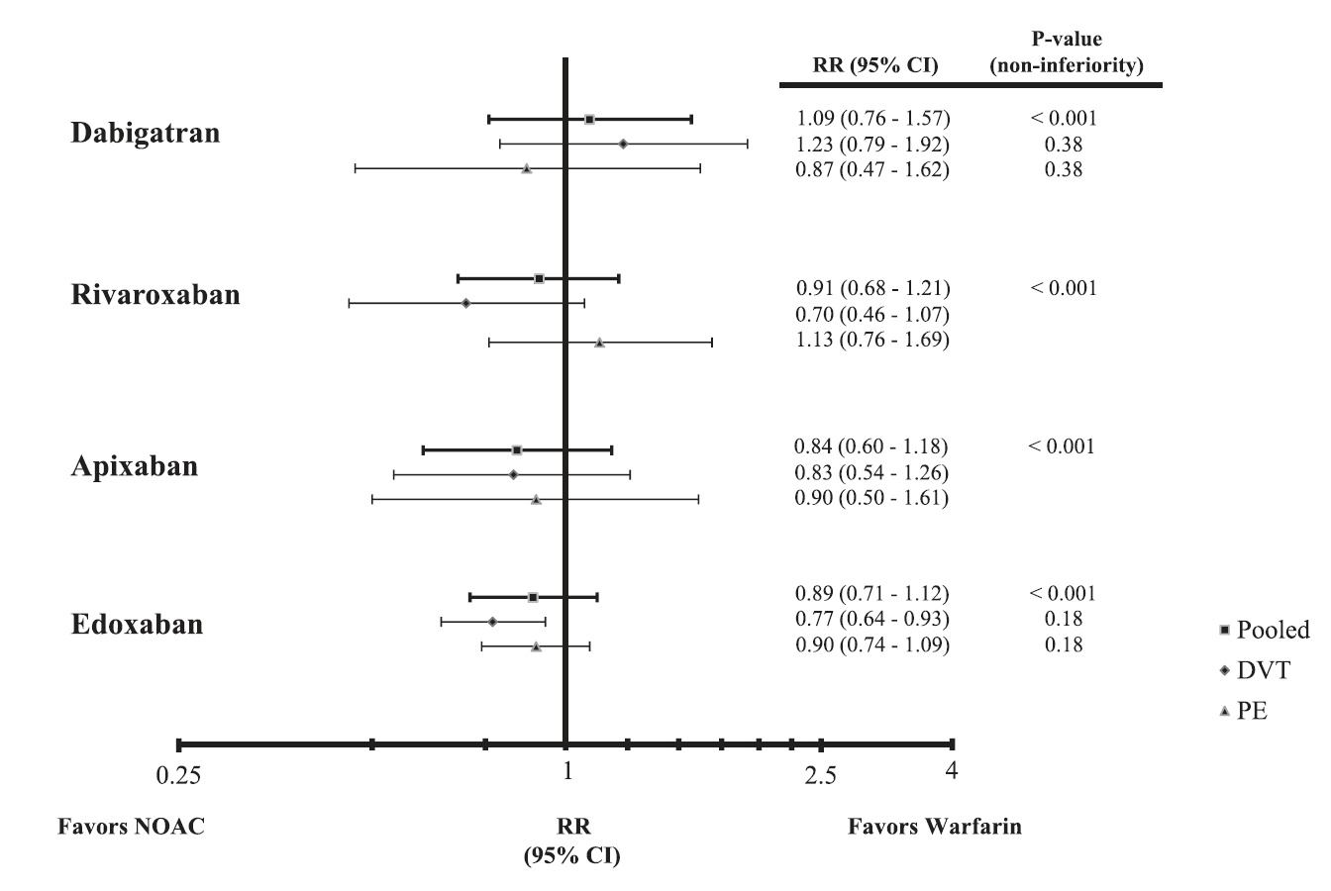

Slide 14
Approach

Slide 15
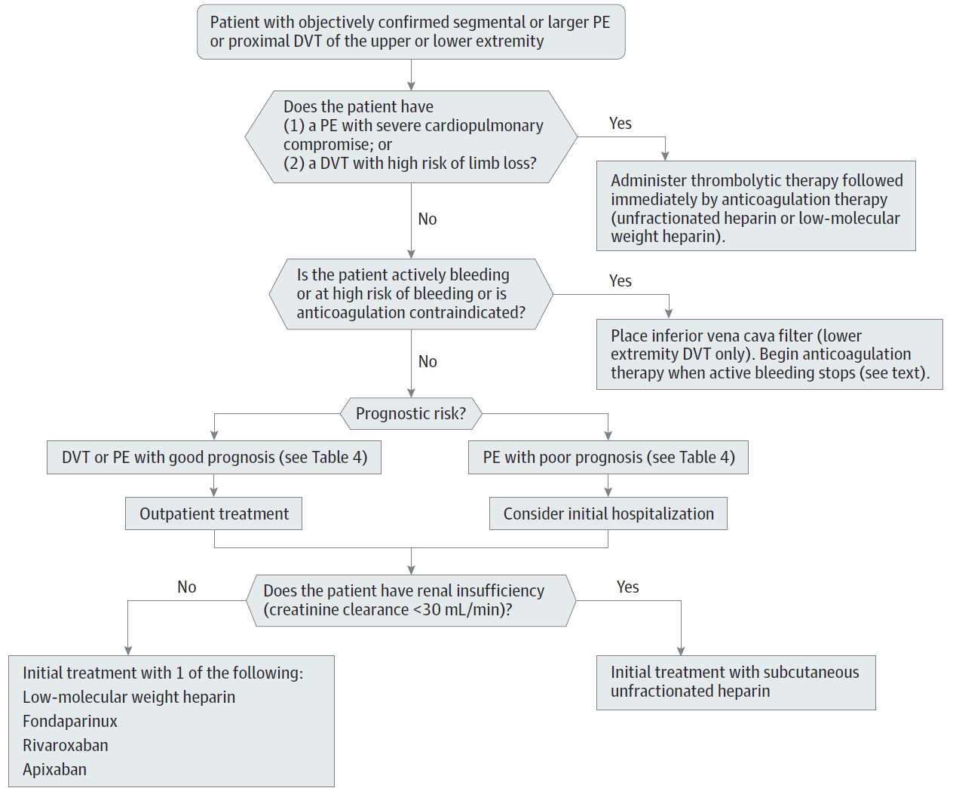
Approach to Acute Treatment of VTE (Onset Through Days 5 to 10)

Slide 16
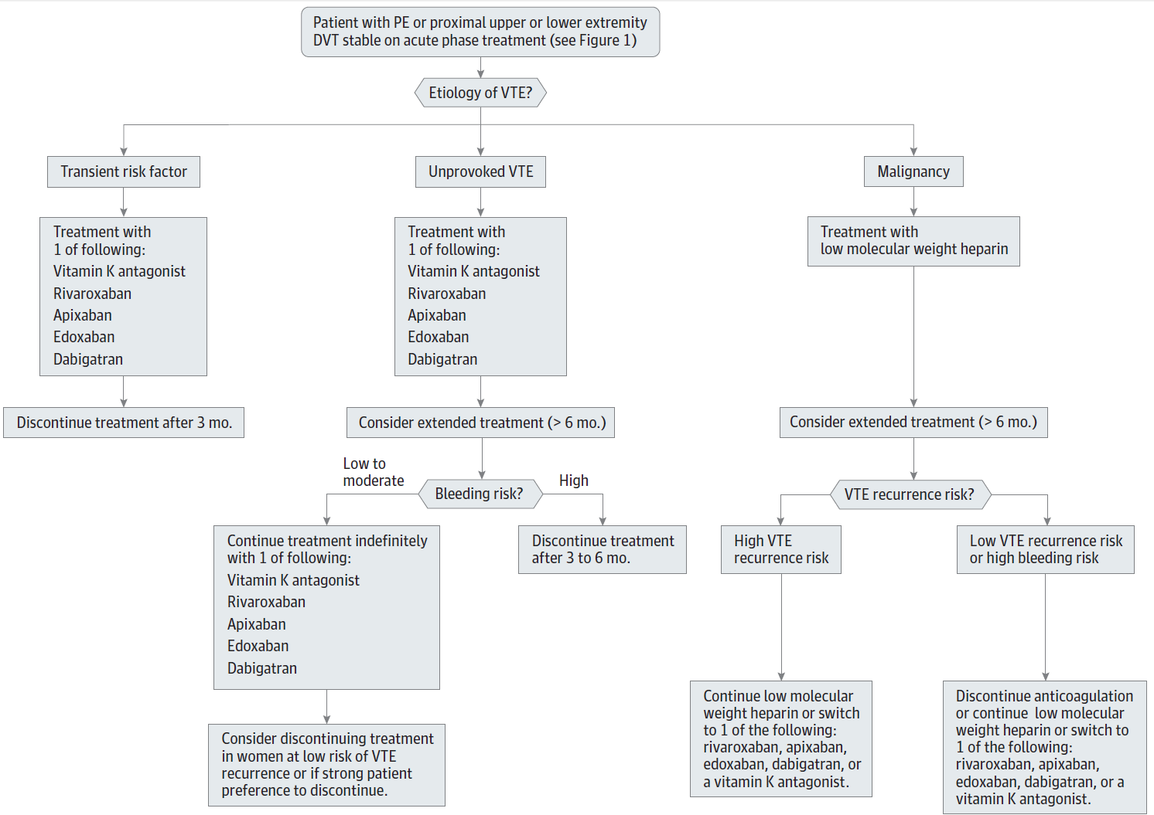
Approach to Long-term and Extended Treatment of VTE (After Acute Treatment Through 3 to 6 Months After Diagnosis)

Slide 17
Choice

Slide 18
NAOCs for acute VTE

Slide 19
N Engl J Med 2010;363:2499-2510

Slide 20
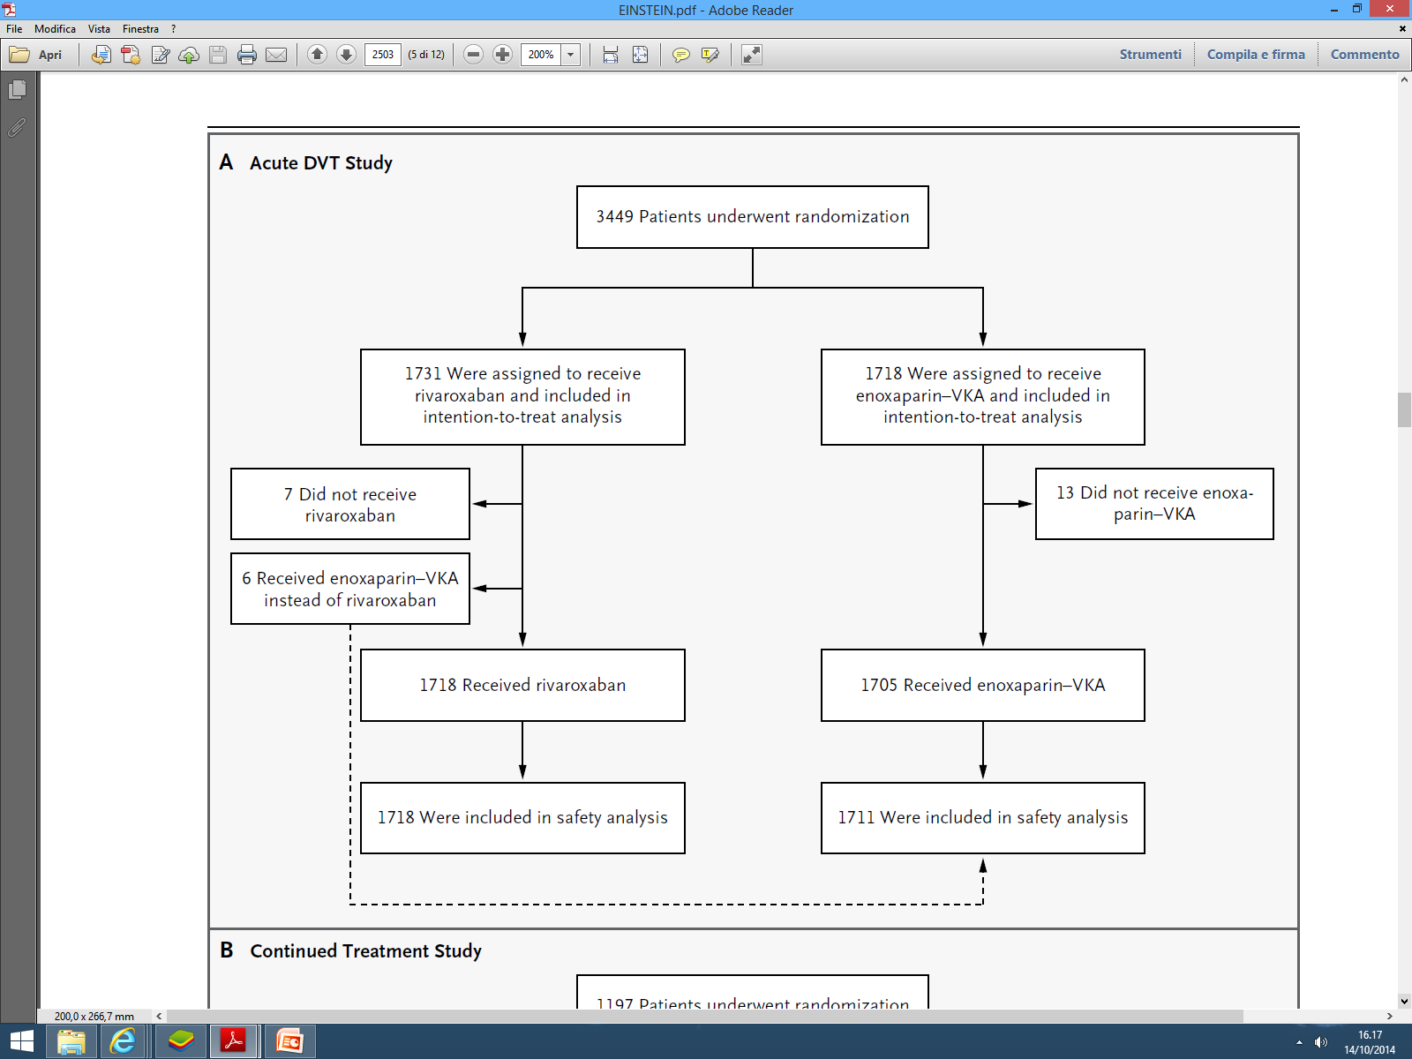
The EINSTEIN
N Engl J Med 2010;363:2499-2510
Treatment Regimens: In the Acute DVT Study, patients assigned to receive oral rivaroxaban were given 15 mg twice daily for the first 3 weeks, followed by 20 mg once daily for the intended 3, 6, or 12 months of treatment. Patients who were assigned to standard therapy received subcutaneous enoxaparin, 1.0 mg per kilogram of body weight twice daily, and either warfarin or acenocoumarol, started within 48 hours after randomization. Enoxaparin was discontinued when the international normalized ratio (INR) was 2.0 or more for 2 consecutive days and the patient had received at least 5 days of enoxaparin treatment. The dose of the vitamin K antagonist was adjusted to maintain an INR of 2.0 to 3.0.

Slide 21
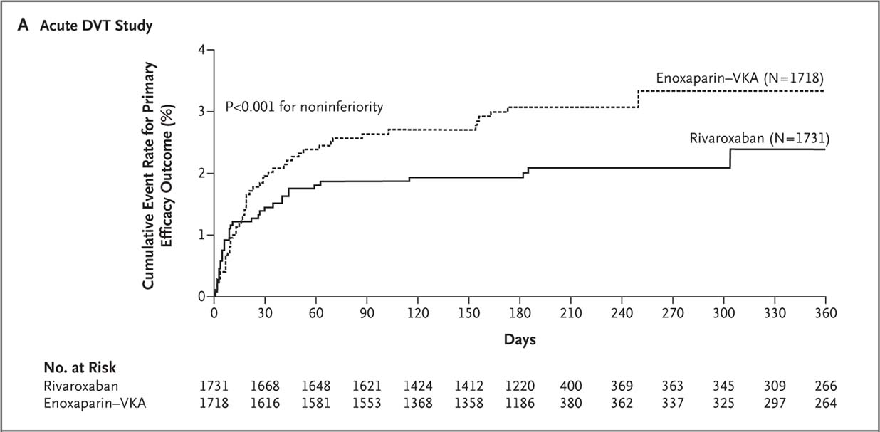
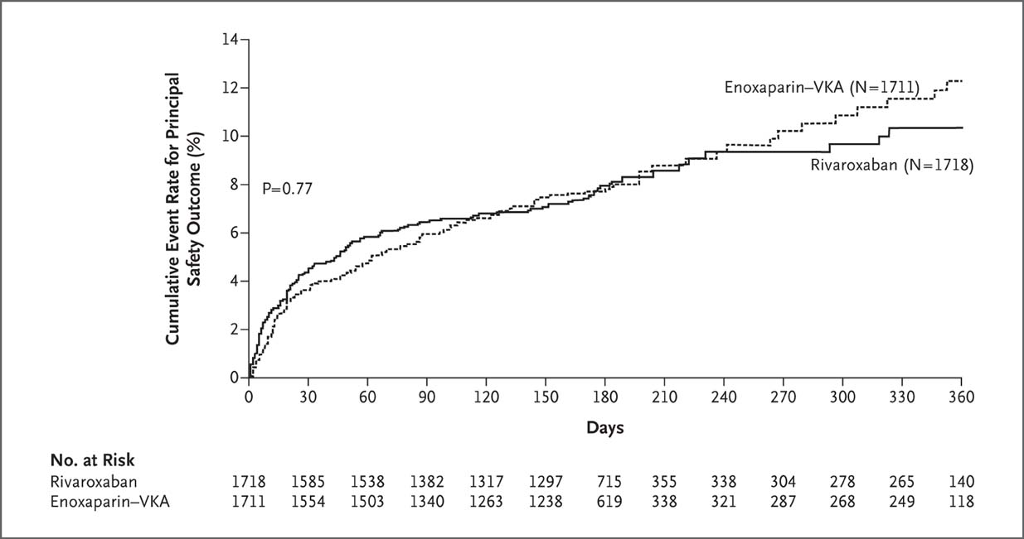
Efficacia
Sicurezza
The EINSTEIN
N Engl J Med 2010;363:2499-2510

Slide 22
Scelta

Slide 23
PRADAXA 150x2
ELIQUIS 5x2
…Estratto Scheda Tecnica Italia

Slide 24
XARELTO 15x2 e 20x1
…Estratto Scheda Tecnica Italia

